Slide 1


Marketing Performance Analysis & ROI Prediction
Insights + Machine Learning Model
Presented by: Your Name

Slide 2
Executive Summary: Key Findings & Actions
Channel Outperformance
Facebook's Efficiency
All marketing channels consistently exceed industry benchmarks, indicating strong overall strategy.
Facebook delivers the highest ROI with the most cost-effective spend, making it a top performer.
Email Overspend
Stable CTR & ML Model
Email marketing shows signs of overspending relative to its return, suggesting budget reallocation opportunities.
Click-Through Rate remains stable at ~14%, reinforced by an ML model predicting ROI based on Engagement, Cost, Channel, and Duration.

Slide 3
Dataset Overview: Comprehensive Campaign Data
Campaign Records
1
Analysis draws from a robust dataset of 200,000 individual campaign records.
Diverse Channels
2
Data spans across key platforms: Facebook, Instagram, YouTube, Google Ads, and Email.
Key Metrics Tracked
3
Core performance indicators include ROI, Conversion Rate (CR), Click-Through Rate (CTR), Engagement Score, and Acquisition Cost.
12-Month Period
4
Insights are derived from a full year of campaign data, ensuring comprehensive trend analysis.

Slide 4
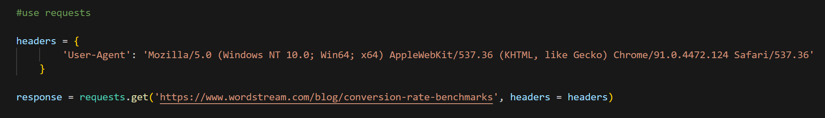
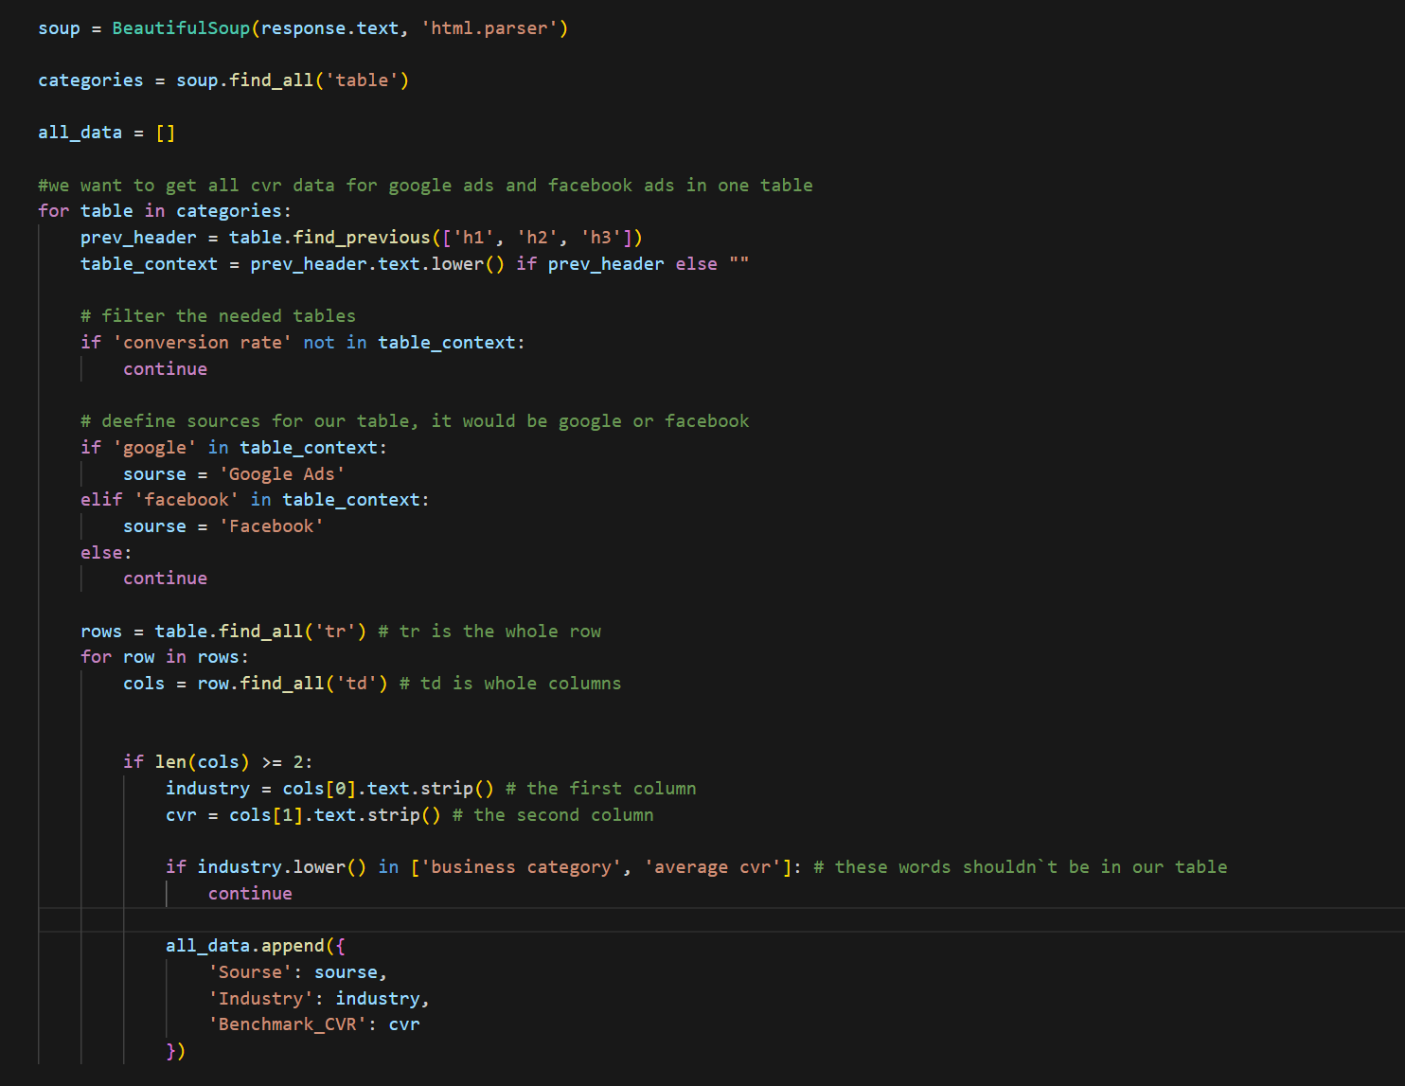
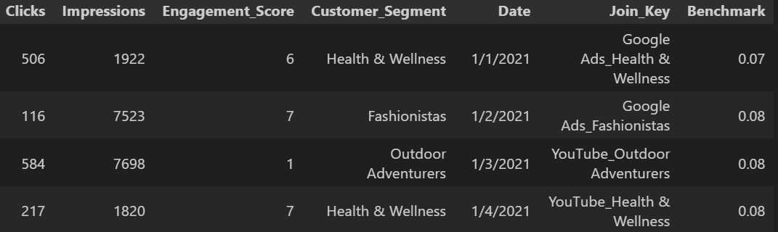
Data Acquisition & Benchmarking Methodology. Hybrid Scraping Approach.
1
Option 1: Request-Based Extraction (Direct)
Demonstrates the ability to retrieve data efficiently by
simulating HTTP requests and handling structured responses
without overhead libraries.
Option 2: HTML Parsing via BeautifulSoup:
Showcases proficiency in navigating and extracting data
from complex DOM structures, ensuring flexibility when
direct data access is restricted.
2
Data Estimation for Other Channels:
The project covers 6 marketing channels.
For channels with missing public data, benchmarks were
calculated by averaging metrics within each consumer
category, ensuring a consistent baseline for the
entire $2.50 Billion portfolio.
Outcome:
A comprehensive, verified dataset that bridges the gap
between internal performance and market standards,
ready for analysis in Excel and ML.
New data
(benchmarks)

Slide 5
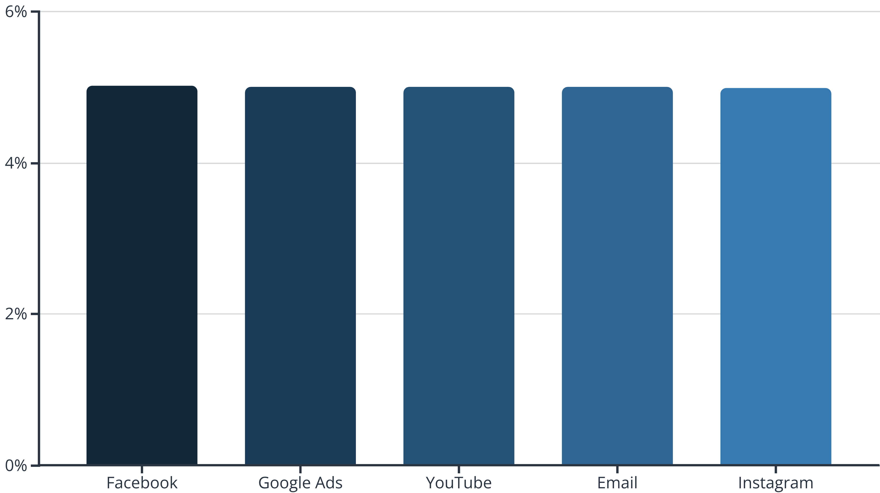
ROI by Channel: Nuanced Performance Differences
While the raw ROI figures appear close, even small percentage differences translate to significant financial impact at scale.
Facebook leads with a 501.87% ROI, underscoring its efficiency. The 3% difference across channels, though seemingly small, represents millions in potential returns.

Slide 6
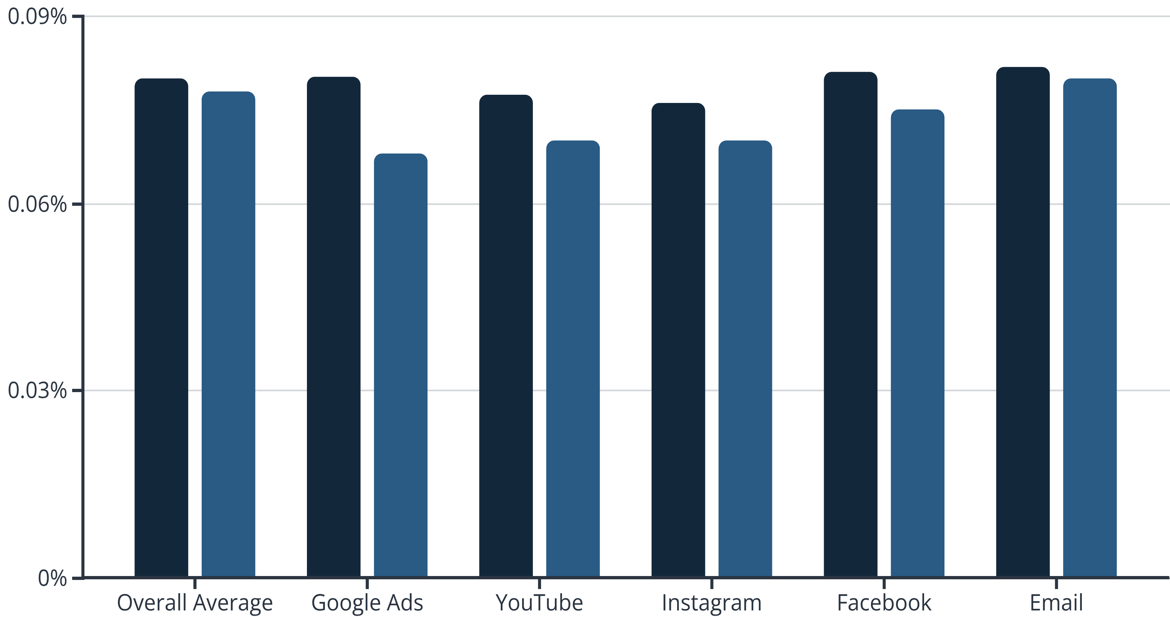
Conversion Rate (CR) vs. Benchmarks
Our overall average conversion rate significantly surpasses industry standards, showcasing effective campaign optimization.
Actual CR
Benchmark CR
Google Ads demonstrates exceptional performance, converting at 8.02% against a 6.81% benchmark. YouTube and Instagram, while generating high Click-Through Rates, show opportunities for Conversion Rate optimization.

Slide 7
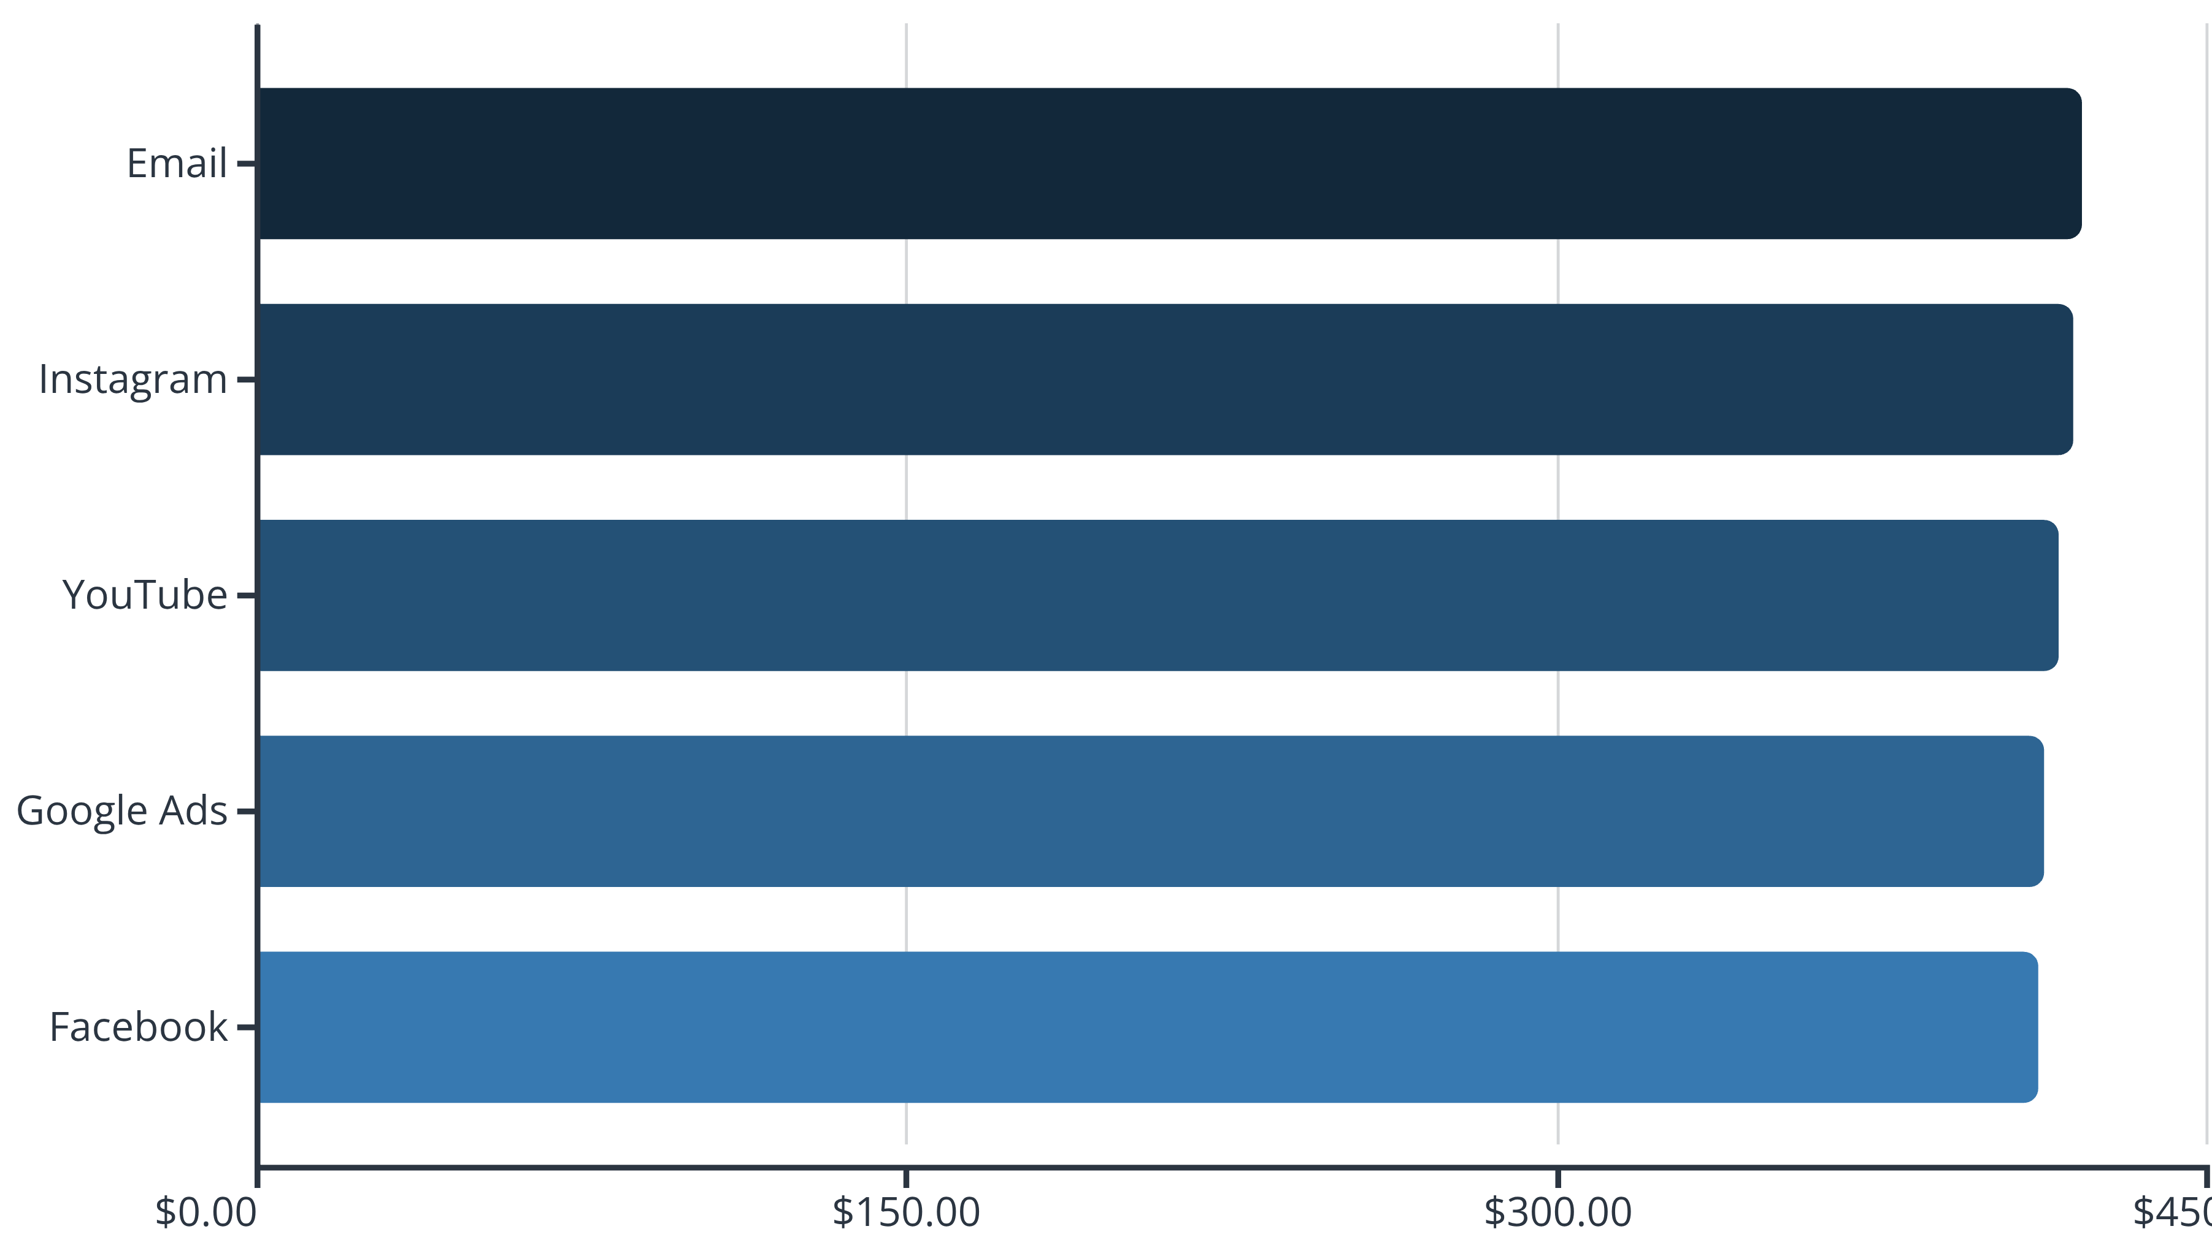

Acquisition Cost Analysis: Efficiency vs. Expenditure
Our data reveals a critical disconnect: higher spending does not always translate to higher ROI. Strategic cost management is key.
Email marketing represents the highest acquisition cost at approximately $420.8M, while Facebook maintains the lowest at $410.6M. This demonstrates that expenditure does not directly correlate with the highest returns, highlighting areas for budget reallocation.
Cost does not directly equal ROI. Focus on efficiency.

Slide 8
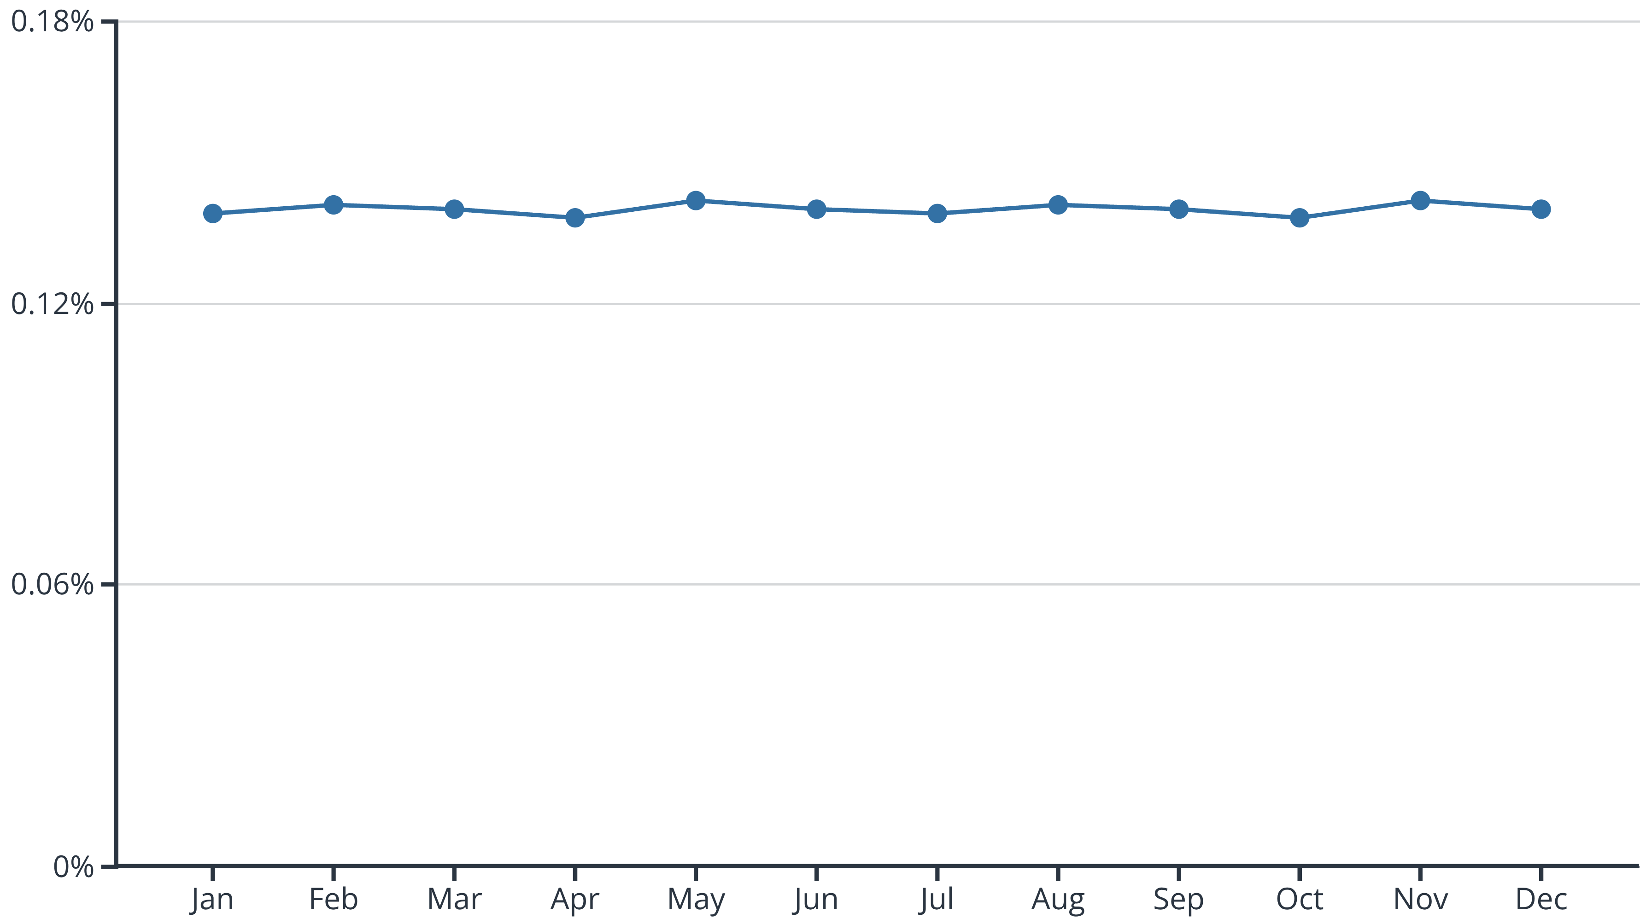
CTR Stability: Consistent Audience Engagement
The unwavering ~14% CTR across all months is a strong indicator of compelling creative and consistent audience relevance.
This consistent performance suggests strong creative consistency and a lack of audience fatigue, indicating a robust content strategy.

Slide 9
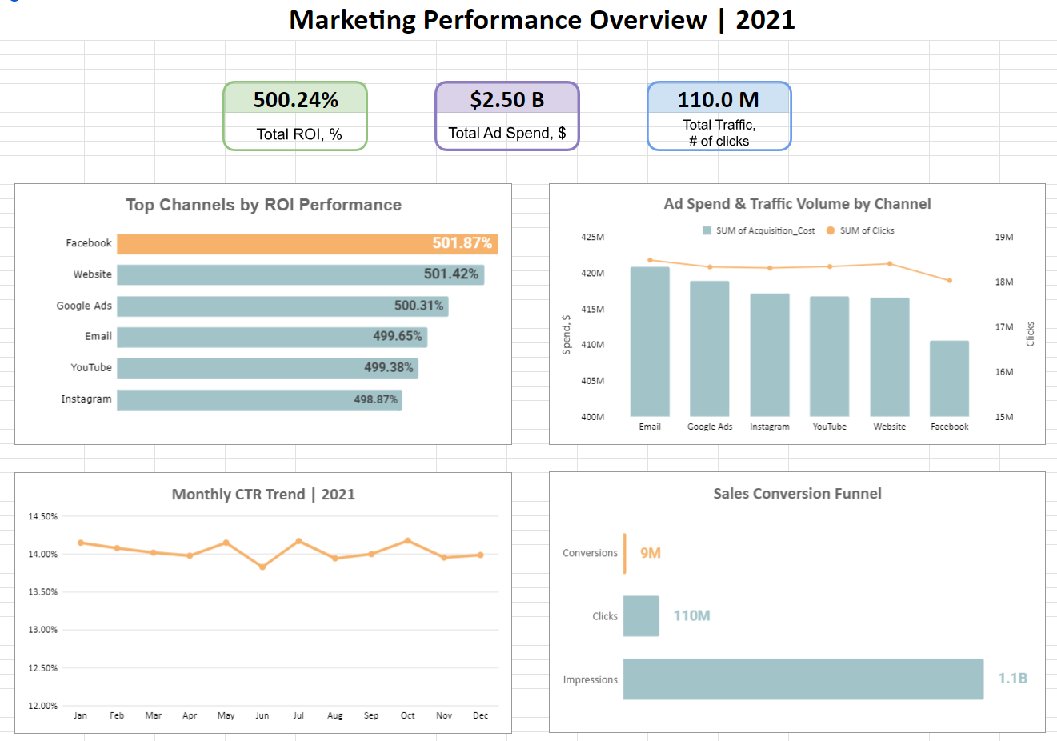
Connecting the Dots: From Granular Data to Executive Insights
The Big Picture:
Our dashboard consolidates 1.1 Billion impressions
into a single, real-time view, allowing for immediate
performance assessment across the entire
$2.50B portfolio.
Performance vs. Context:
By integrating the scraped benchmarks directly into
the visual interface, we can see that while Facebook
leads in ROI (501.87%), Google Ads remains the most
consistent over-performer relative to market standards.
Strategic Stability:
The dashboard highlights a remarkably stable CTR
of ~14%, confirming that our audience targeting
remains effective throughout the fiscal year.
Actionable Intelligence:
This unified view allows us to spot the
"Conversion Gap" in channels like Instagram and
YouTube, directing our focus toward landing page
optimization to match Facebook's efficiency.

Slide 10

Machine Learning Model: Predicting Future ROI
We've developed a Random Forest Regressor model to accurately predict campaign ROI, leveraging key performance drivers.
1
2
Model Type: Random Forest Regressor
Key Features Utilized
Engagement Score, Acquisition Cost, Channel, and Duration are the primary inputs for ROI prediction.
Selected for its ability to handle complex, non-linear relationships and robustness to noisy data.
3
Purpose: Proactive ROI Prediction
The model's core function is to forecast ROI for new or planned campaigns, enabling data-driven decision-making.

Slide 11
Model Performance: Understanding ROI Stability
Our model confirms the inherent stability of ROI across campaigns, providing reliable predictions for average performance.
X
X
~0
Mean Absolute Error (MAE)
Root Mean Squared Error (RMSE)
R-squared (R²)
Indicates the average magnitude of the errors in a set of predictions, without considering their direction.
Expected due to low variance in ROI, indicating that the model reliably predicts the average ROI rather than individual fluctuations.
Measures the average magnitude of the errors. Higher weight is given to larger errors.
The low R² value is not a limitation but a reflection of the consistent ROI. This means the model excels at predicting the highly stable average ROI, which is invaluable for consistent budget allocation.

Slide 12





Strategic Recommendations: Optimizing for Growth
Increase Facebook Budget
Boost Facebook spend by 10-15% due to its consistently highest ROI and lowest acquisition cost, maximizing efficient returns.
Re-evaluate Email Spend
Conduct a thorough review of email marketing expenses. Its highest cost and lower efficiency suggest potential for budget reallocation or strategy refinement.
Improve CVR on YouTube & Instagram
Focus on optimizing conversion rates for YouTube and Instagram. Even a marginal +0.02% increase can translate to thousands of additional conversions.
Optimize Landing Page UX
Prioritize enhancing the user experience on landing pages, especially for mobile traffic originating from social channels, to reduce bounce rates and improve conversions.

